Slide 1


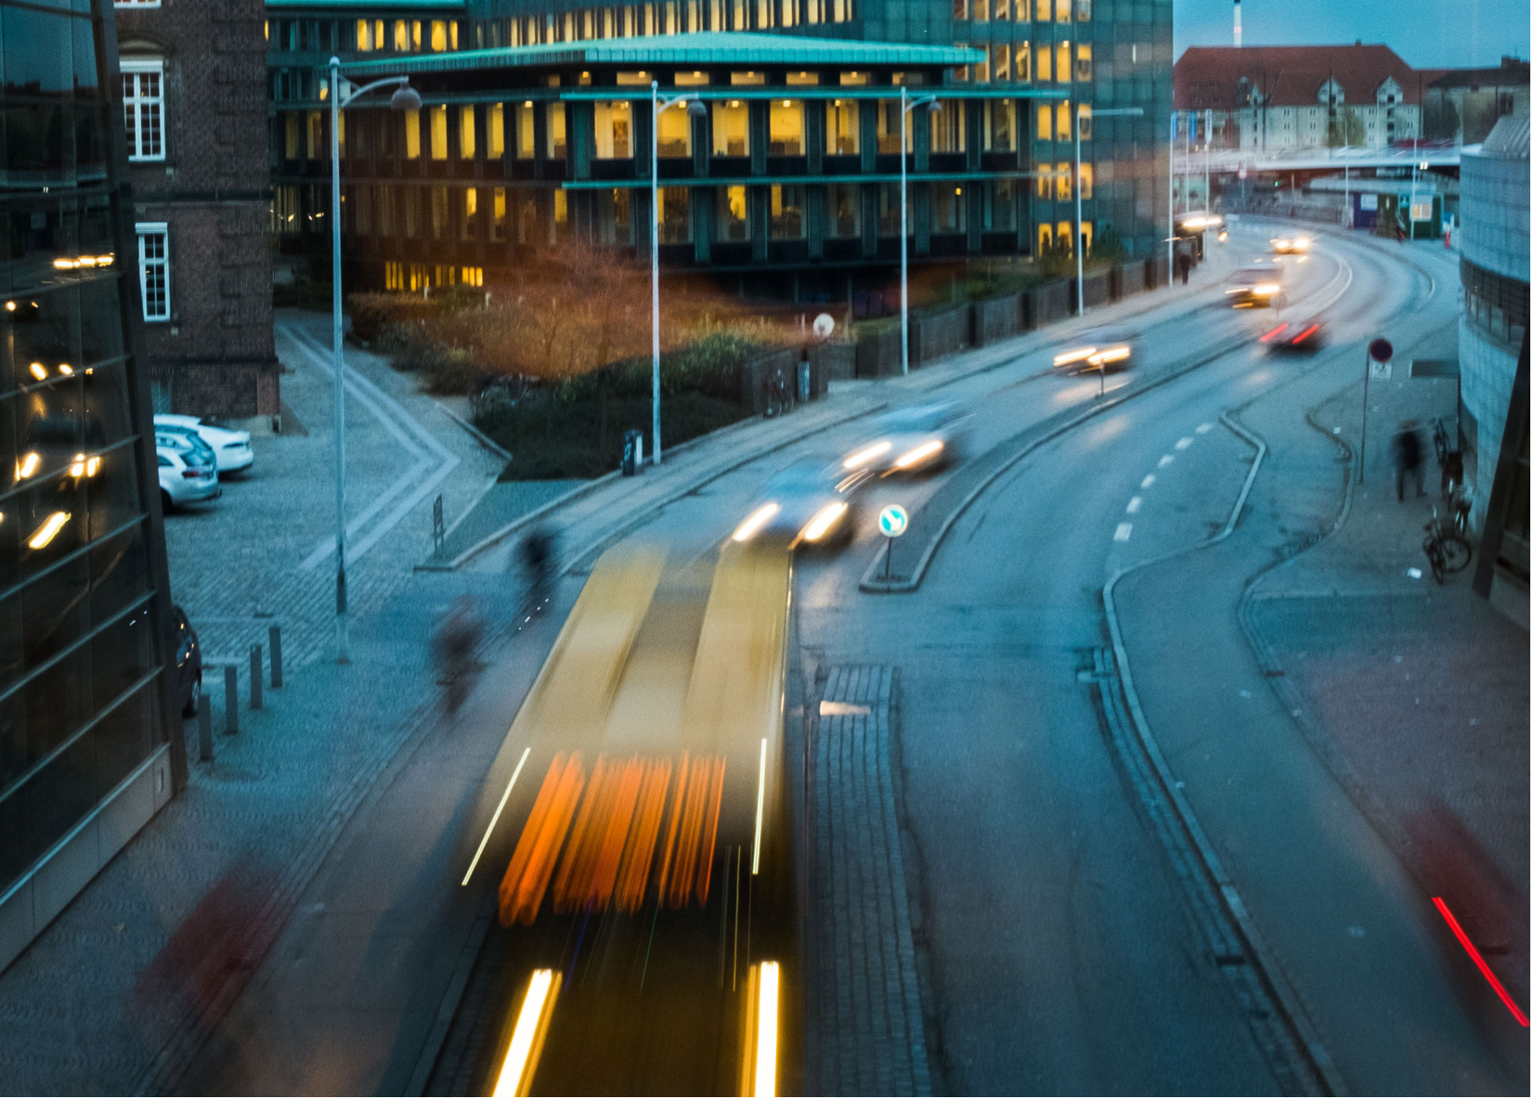
PCC Rise 2021 How will a tolling scheme impact the inner city of Copenhagen?
Harry Politer and the Case Competition
- Gustav Holm, Jeppe Vanderhaegen and Asger Damgaard-Sørensen

Slide 2
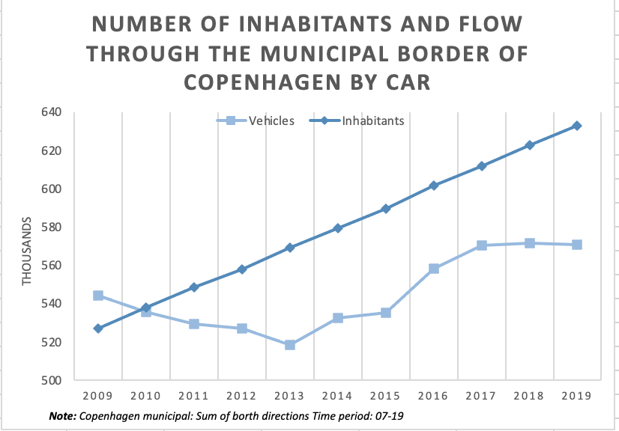
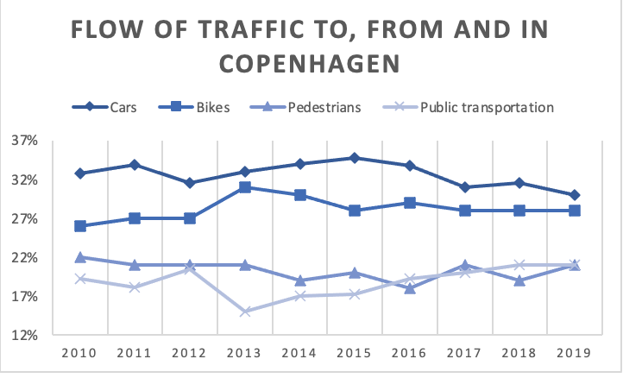

An increase in inhabitants of Copenhagen and flow through the municipal border of Copenhagen has been leading to higher $CO^{2}$-emissions and higher congestion.
An increase in inhabitants of 22.5% since 2008.
An increase in flow through municipal border of 5%
No major change in mode of transportation

Slide 3
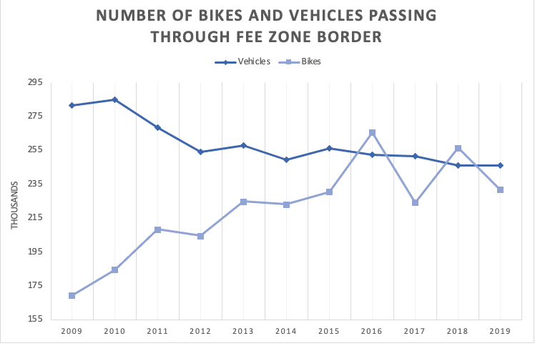
Data shows the quantity of vehicles in the proposed fee zone has been relatively steady over the past years. Therefore, a need for political intervention
Equilibrium reached for traffic flow in proposed fee zone without consideration of congestion etc.
No further short term decline in number of cars in the proposed fee zone
A necessary political intervention

Slide 4
Our recommendation: Implementing the proposed fee zone would reduce total amount of vehicles in the proposed zone significantly
 | Stockholm | London
Congestion reduce in fee zone. | 25% | 18%
Payment system. | 0-26DKK (Variable Fee) | 96DKK (Flat Fee)
Size of fee zone. | 35km² | 21km²
Expected congestion reduce in proposed fee zone calculated on city comparison. | 14.2% | 15.31%
Expected total car reduce in Copenhagen fee zone. | 34,986 | 37,697
Having a flat fee in the proposed fee zone will decrease the flow of traffic between 14.2% or 15.31%
Expected reduction in absolute numbers when equilibrium is reached between 34,986 or 37,697
An increase in fee zone would cause further decrease in number of cars

Slide 5
Implementing the fee zone will give the City of Copenhagen a net loss of 1.346bn DKK
Total Cost 1356158
Total Benefits 9337
Net cost 1346820
Note: In thousands DKK. The cost-benefit analysis is based on an average of the two expected congestion reduces
The operating system constitutes the majority of the cost.
No consideration of the increase in public transport revenue and bike sales

Slide 6
Implementing a toll fee proportional to the value of the vehicle would have a positive effect on the socio-economic benefits and cost.
The proposed fee zone would lead to fewer accidents involving vehicles and less noise pollution
A flat fee would have a greater impact on low-income inhabitants
A fee proportional to the value of the vehicle would level out socio-economic differences
Fewer accidents involving vehicles |  | 1,090,235 DKK
Less noise pollution |  | 726,823 DKK
Note: In thousands DKK

Slide 7
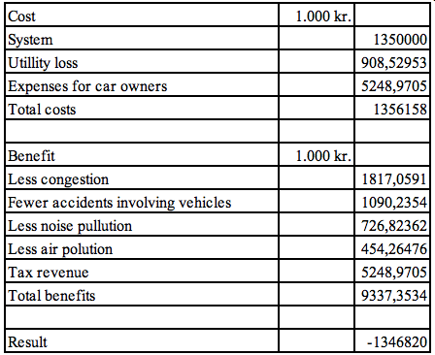
Appendics
Full Table of Cost-Benefit

